Slide 1
Network Layer
Copyright © The McGraw-Hill Companies, Inc. Permission required for reproduction or display.

Slide 2
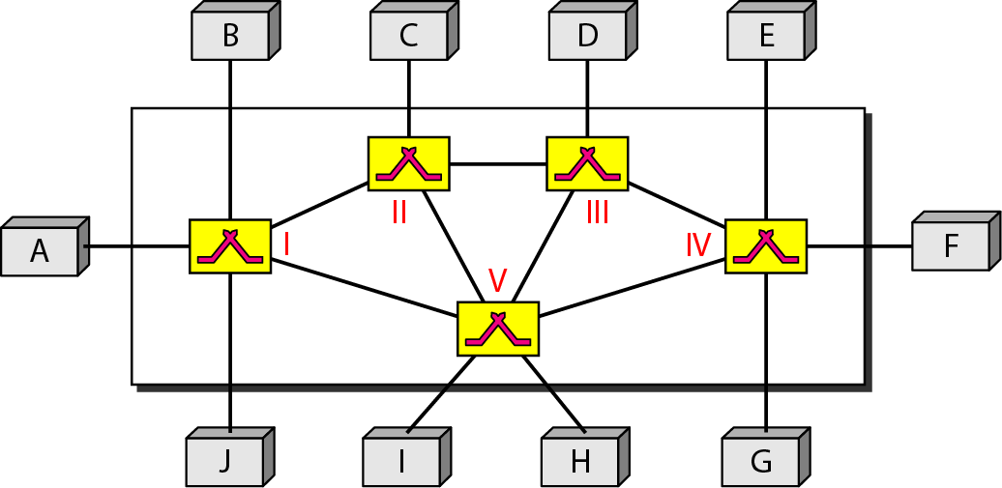
Switching
Switches are devices capable of creating temporary connections between two or more devices linked to the switch.
In a switched network, some of these nodes are connected to the end systems (computers or telephones, for example).

Slide 3
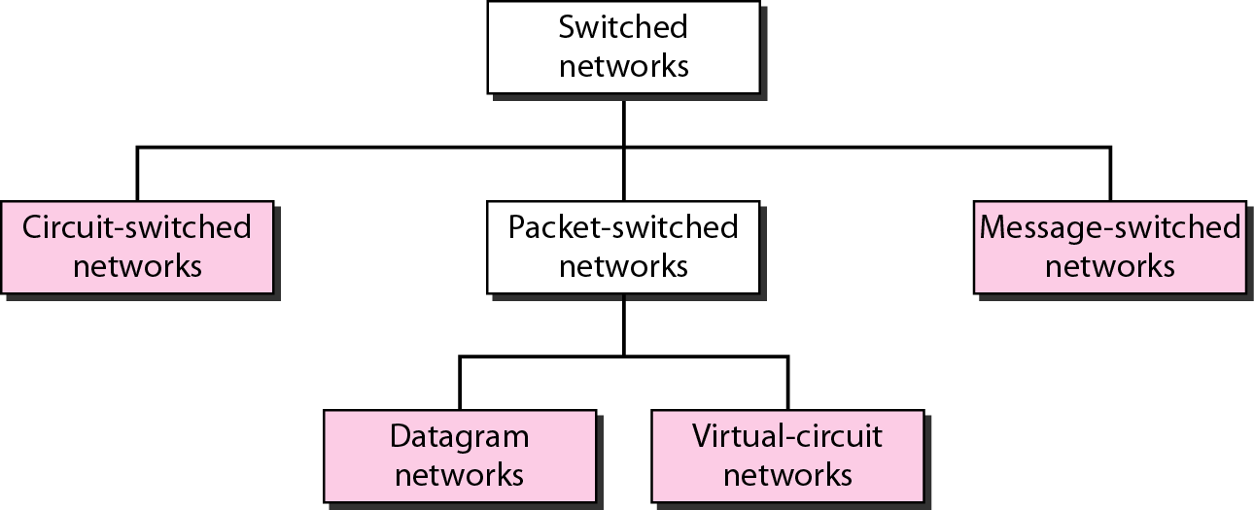
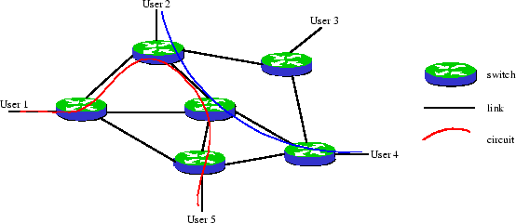
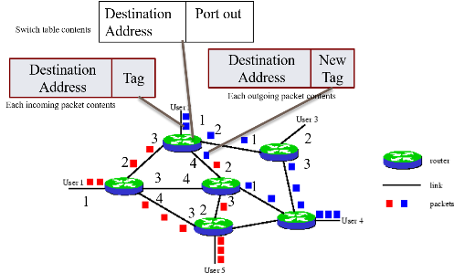
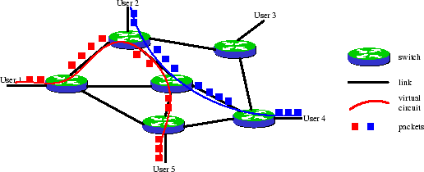
Figure Taxonomy of switched networks

Slide 4
8-1 CIRCUIT-SWITCHED NETWORKS
A circuit-switched network is made of a set of switches connected by physical links, in which each link is divided into n channels. Each link is normally divided into n channels by using FDM or TDM.
Establish
Transfer
Disconnect

Slide 5
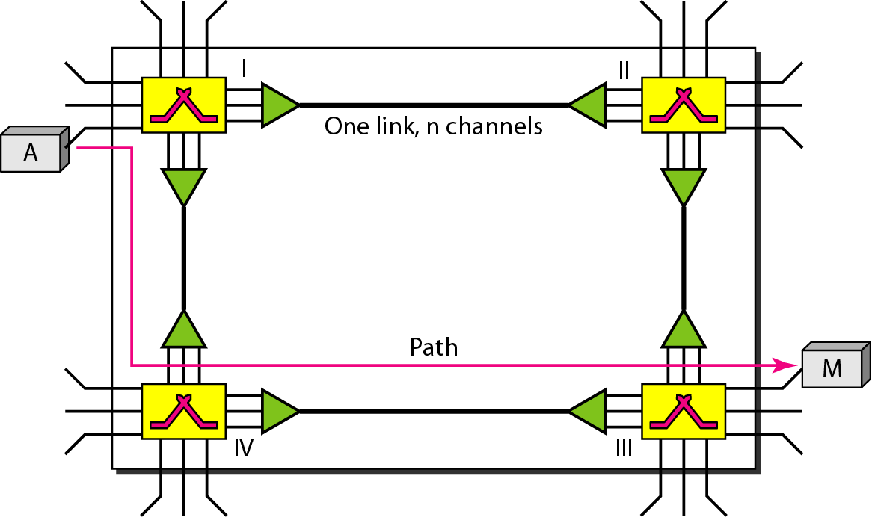
Figure 8.3 A trivial circuit-switched network
Notes:
1.Phy layer
2.

Slide 6
In circuit switching, the resources need to be reserved during the setup phase; the resources remain dedicated for the entire duration of data transfer until the teardown phase.
Not efficient

Slide 7
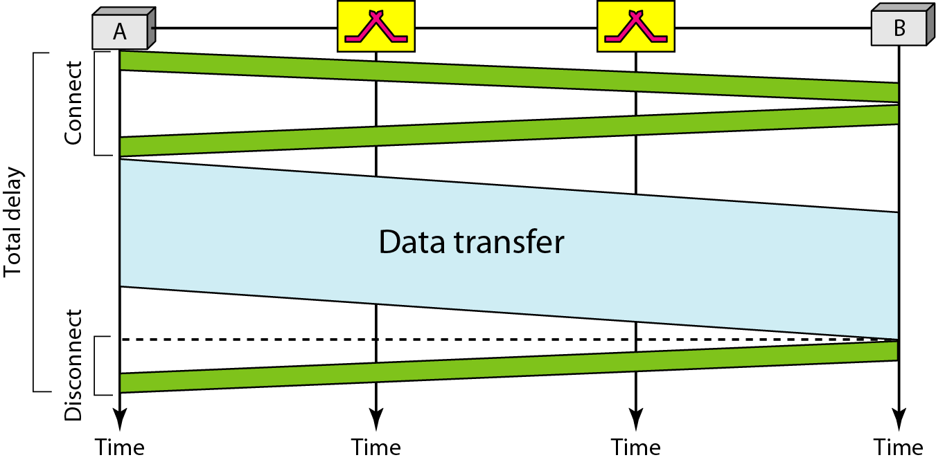
Figure 8.6 Delay in a circuit-switched network

Slide 8
Total Delay for Circuit Switched Network
Transmission Delay, T & Propagation Delay, P
Setup time, ST= Req Pkt +Ack Pkt
= T_{s}+P_{s}+ T_{D}+P_{D.}
Data Transfer, DT= T_{data}+ P_{data.}
Disconnect Time, DCT= T_{D}+P_{D.}
Total Delay=ST+DT+ DCT
Note : ignoring processing time in each switch

Slide 9
Switching at the physical layer in the traditional telephone network uses
the circuit-switching approach.

Slide 10
8-2 Packet Switching
If the message is going to pass through a packet-switched network, it needs to be divided into packets of fixed or variable size.
The size of the packet is determined by the network and the governing protocol.

Slide 11
Two Basic Forms of Packet Switching
Packets handled in two ways
Datagram
Virtual circuit

Slide 12
Datagram
Each packet treated independently
Packets can take any practical route
Packets may arrive out of order
Packets may get lost or delayed
Up to receiver to re-order packets and recover from missing packets

Slide 13
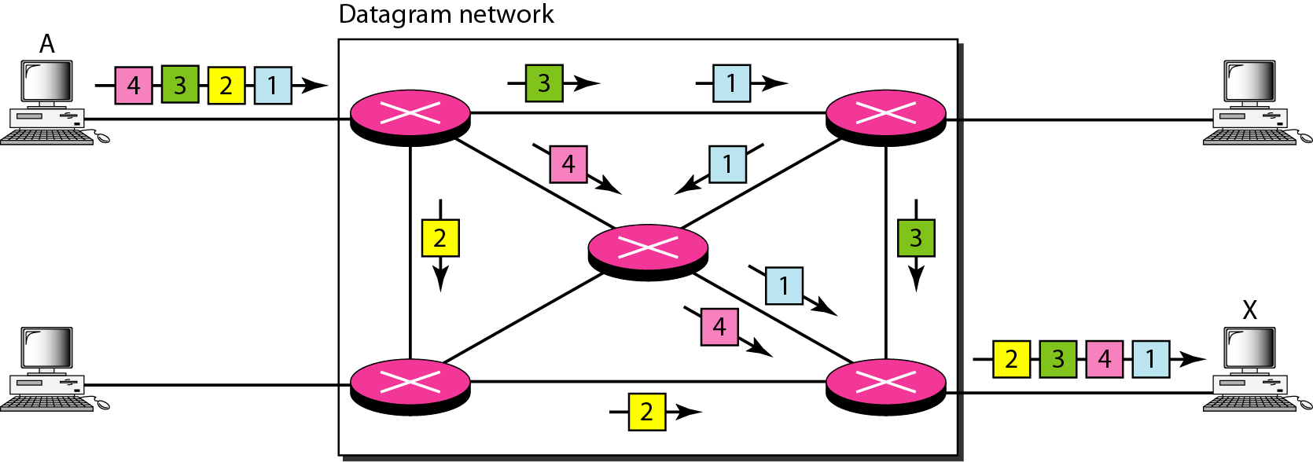
Figure 8.7 A datagram network with four switches (routers)
Switches in a datagram network are traditionally referred to as routers.

Slide 14
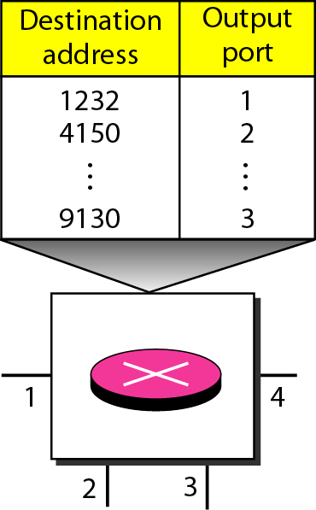
Figure 8.8 Routing table in a datagram network

Slide 15
The destination address in the header of a packet in a datagram network
remains the same during the entire journey of the packet.

Slide 16
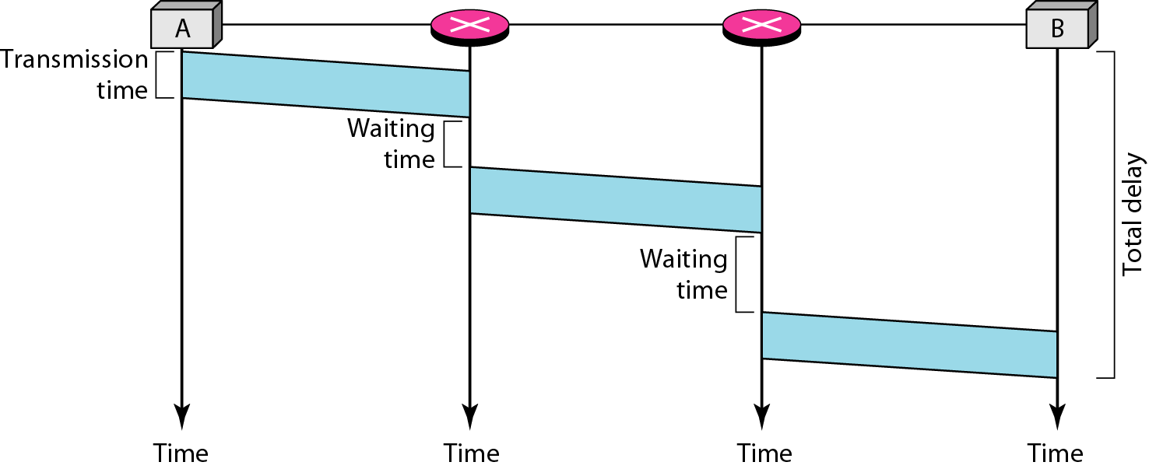
Figure 8.9 Delay in a datagram network

Slide 17
Total Delay
Transmission Delay,T
Propagation Delay,P
Waiting Time ,w_{i}
Total Delay=3T+3P+w₁ +w₂
Note : ignoring processing time in each switch

Slide 18
Virtual Circuit
Preplanned route established before any packets sent
Call request and call accept packets establish connection (handshake)
Each packet contains a virtual circuit identifier instead of destination address

Slide 19
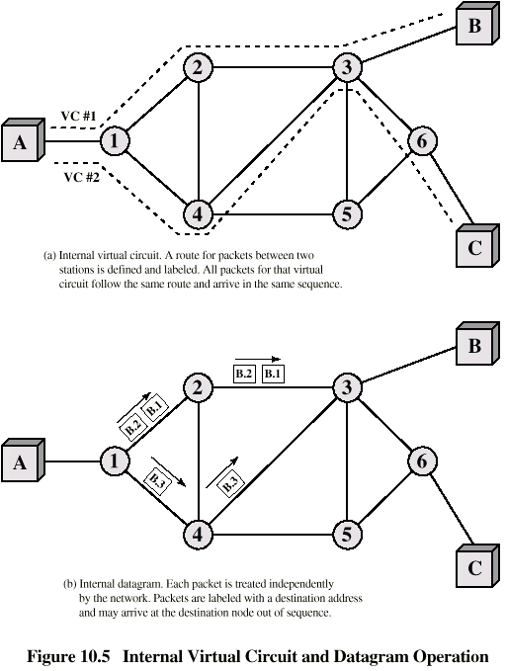
Internal Virtual Circuit and Datagram Operation

Slide 20

Note
A switch in a datagram network uses a routing table that is based on the destination address.

Slide 21
Note
Switching in the Internet is done by using the datagram approach to packet switching at the network layer.

Slide 22
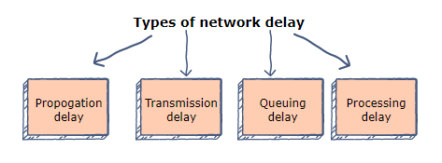
Different Types of Network Delay
Network delay refers to the amount of time it takes for a packet to go from point A to point B.
Notes:
If Point A is the source and point B is the destination, then the delay is called an end to end delay.

Slide 23

Propagation delay
The time that it takes for a bit to reach from one end of a link to the other.
The delay depends on the distance (D) between the sender and the receiver, and the propagation speed (S) of the wave signal.
It is calculated as:

Slide 24

Transmission delay
Transmission delay refers to the time it takes to transmit a data packet onto the outgoing link.
The delay is determined by the size of the packet and the capacity of the outgoing link.
If a packet consists of L bits and the link has a capacity of B bits per second, then the transmission delay is equal to:

Slide 25
Other Delays
Queuing delay
The time that a packet waits to be processed in the buffer of a switch.
The delay is dependent on the arrival rate of the incoming packets, the transmission capacity of the outgoing link, and the nature of the network’s​ traffic.
Processing delay
Processing delay is the time taken by a switch to process the packet header.
The delay depends on the processing speed of the switch.

Slide 26
Example
1) A is source, B is destination. A and B are separated by a distance of 48,000kms. A sends 1500 bytes to B at the rate of 100 Mbps. The signal propagates at 2.4 x 10^8 mps. Compute the propagation delay and transmission delay considering there is no other intermediate device.

Slide 27
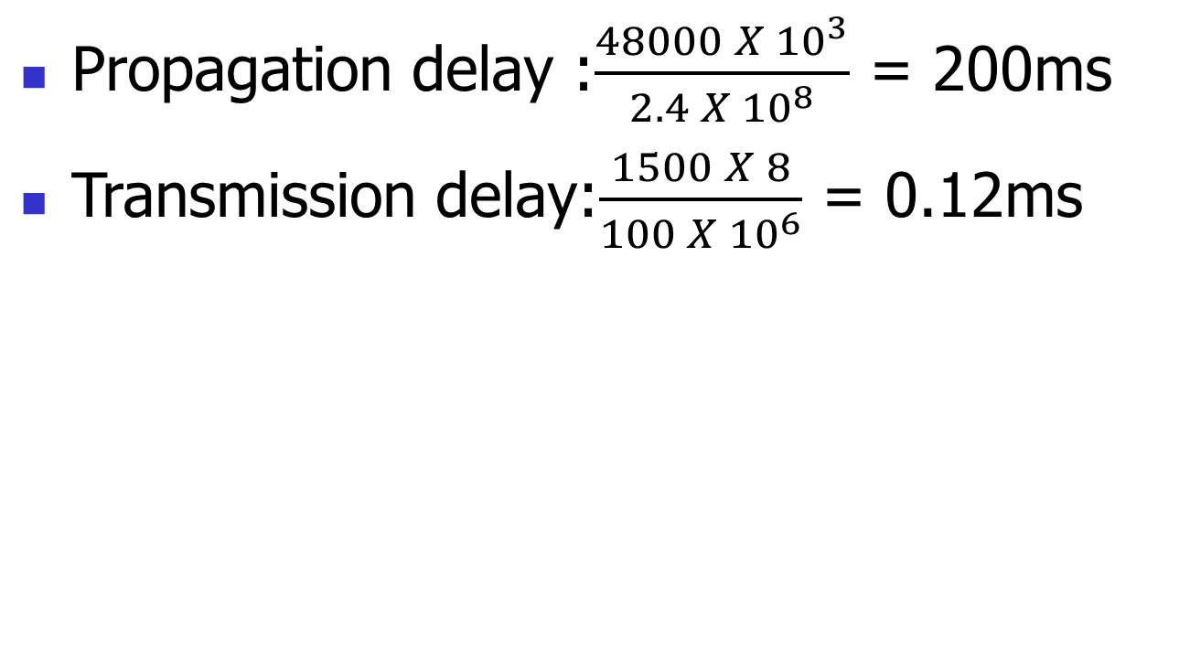

Slide 28
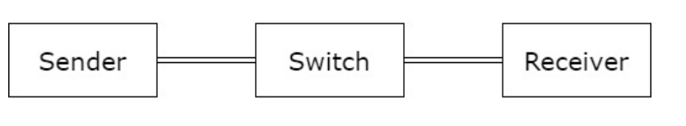
2) Sender and Receiver separated by 1Gbps link. Packet size is 5000 bits. Each link introduces a delay of 10µs. Assume switch immediately forwards the data after it receives the last bit of the packet. Ignore queuing delay. Compute the total delay

Slide 29
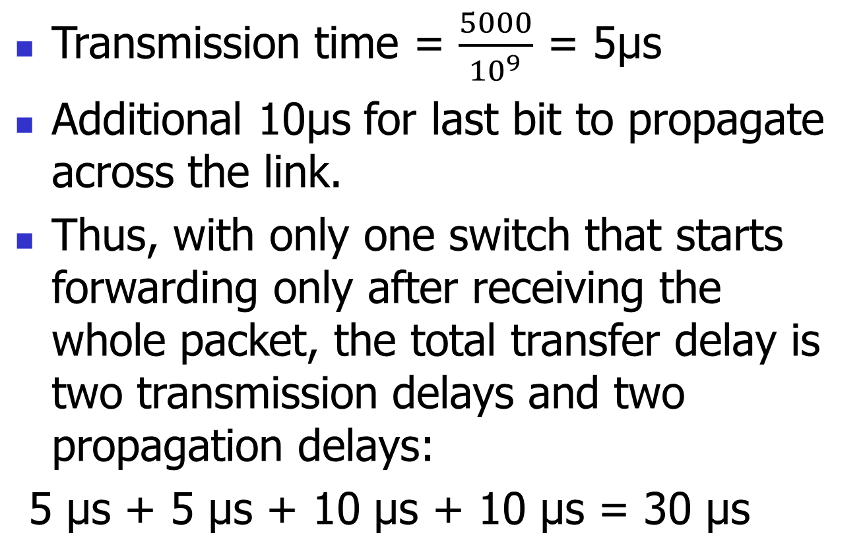
30µs

Slide 30
2B) What is the delay if the sender and receiver is separated by three switches in between?
Three switches and thus four links implies the total delay is four transmission delays and four propagation delays: 60µs

Slide 31
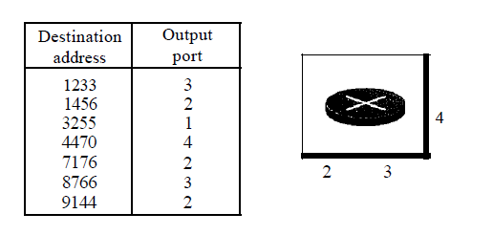
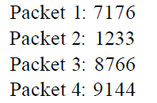
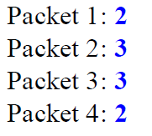
3)
Figure below shows a switch (router) in a datagram network.
Find the output port for packets with the following destination addresses:
Solution

Slide 32
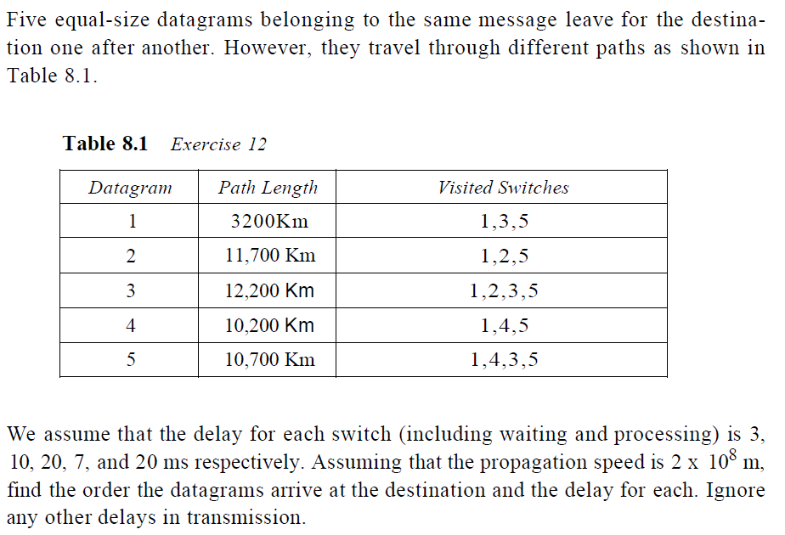
4)

Slide 33
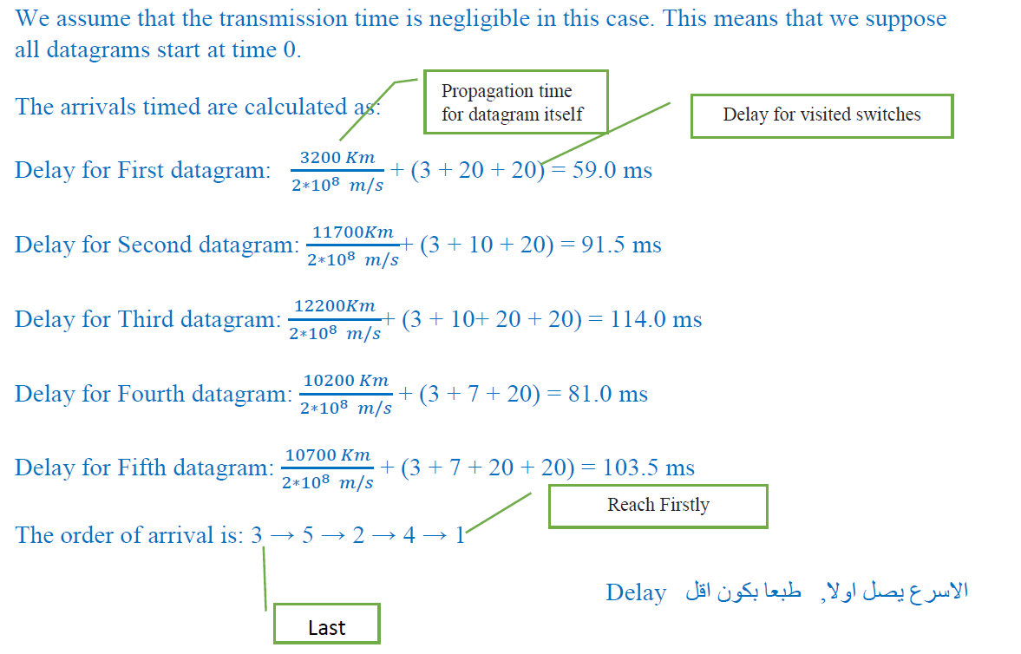

Slide 34
4-4 NETWORK LAYER SERVICES
Logical Addressing
Services Provided at the Source Computer
Services Provides at the Each Router
Services Provided at the Destination Computer

Slide 35
Figure 4.12 An imaginary part of the Internet

Slide 36
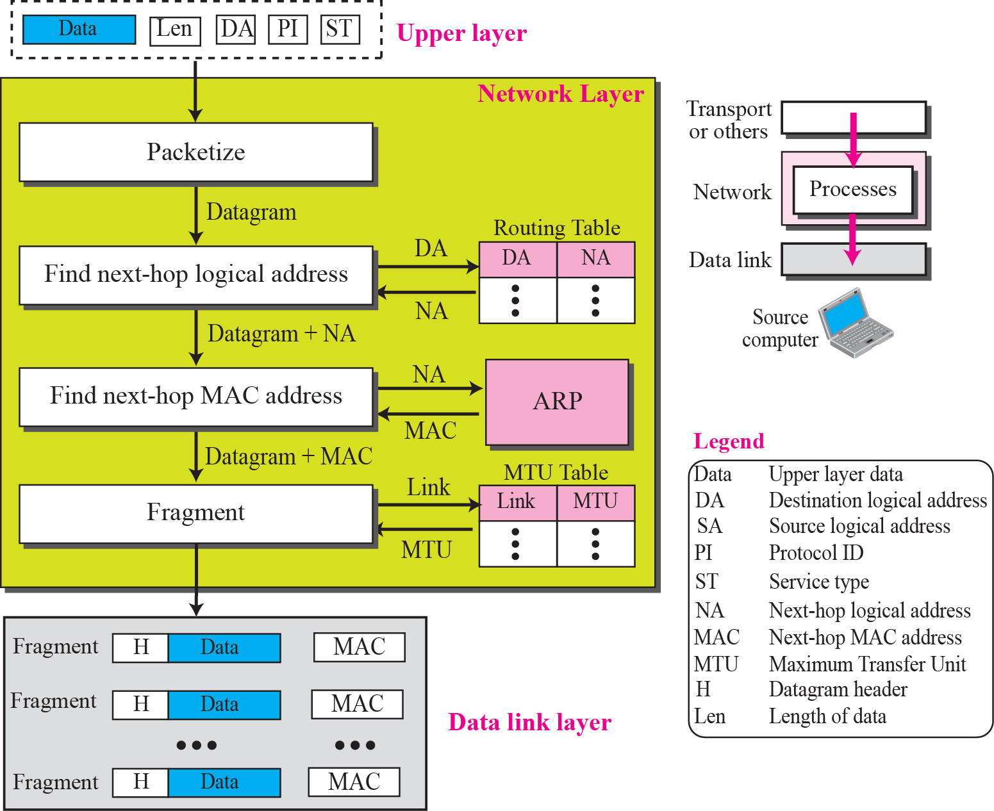
Figure 4.13 Services provided at the source computer

Slide 37
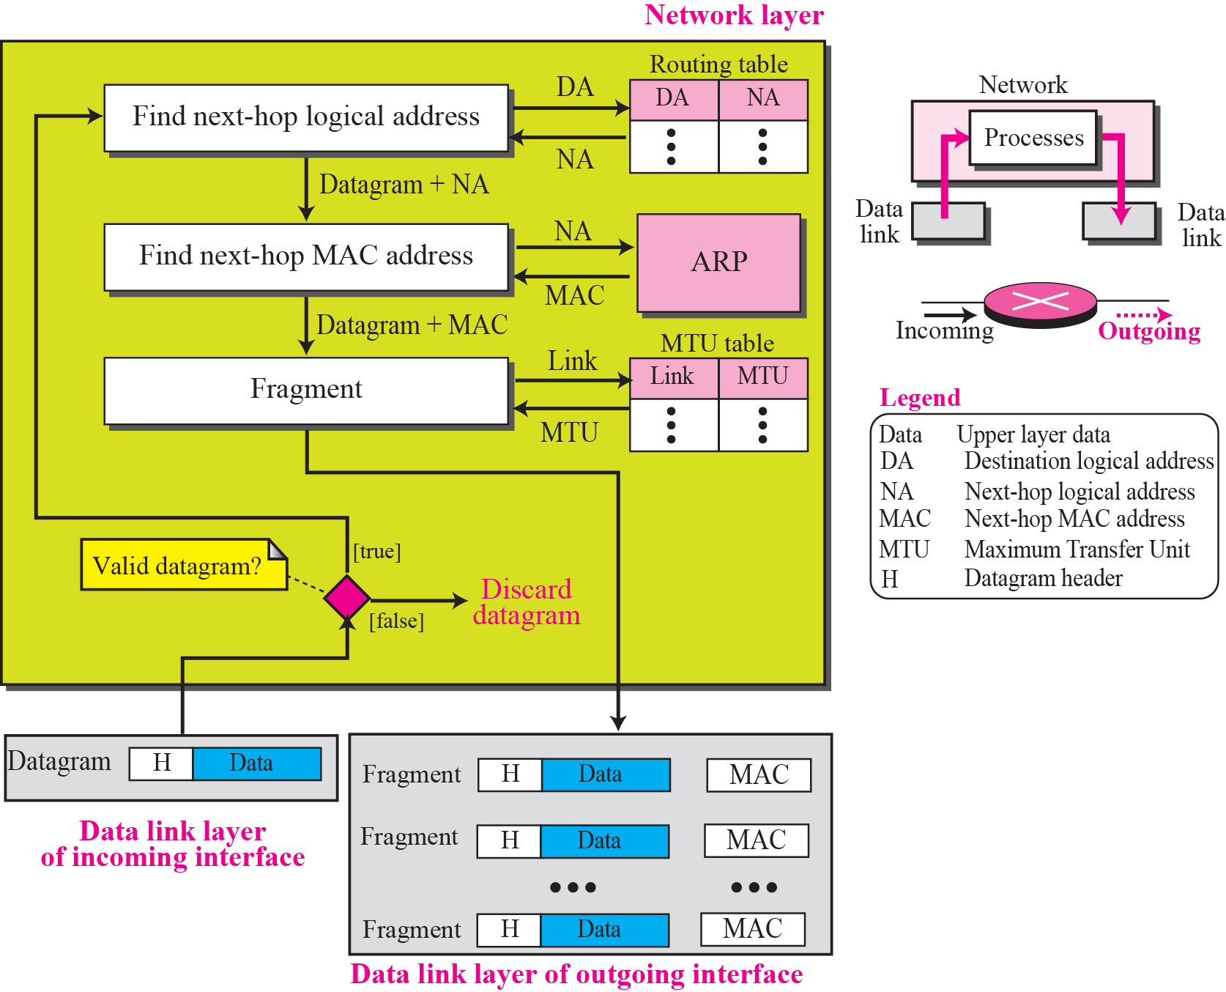
Figure 4.14 Processing at each router

Slide 38
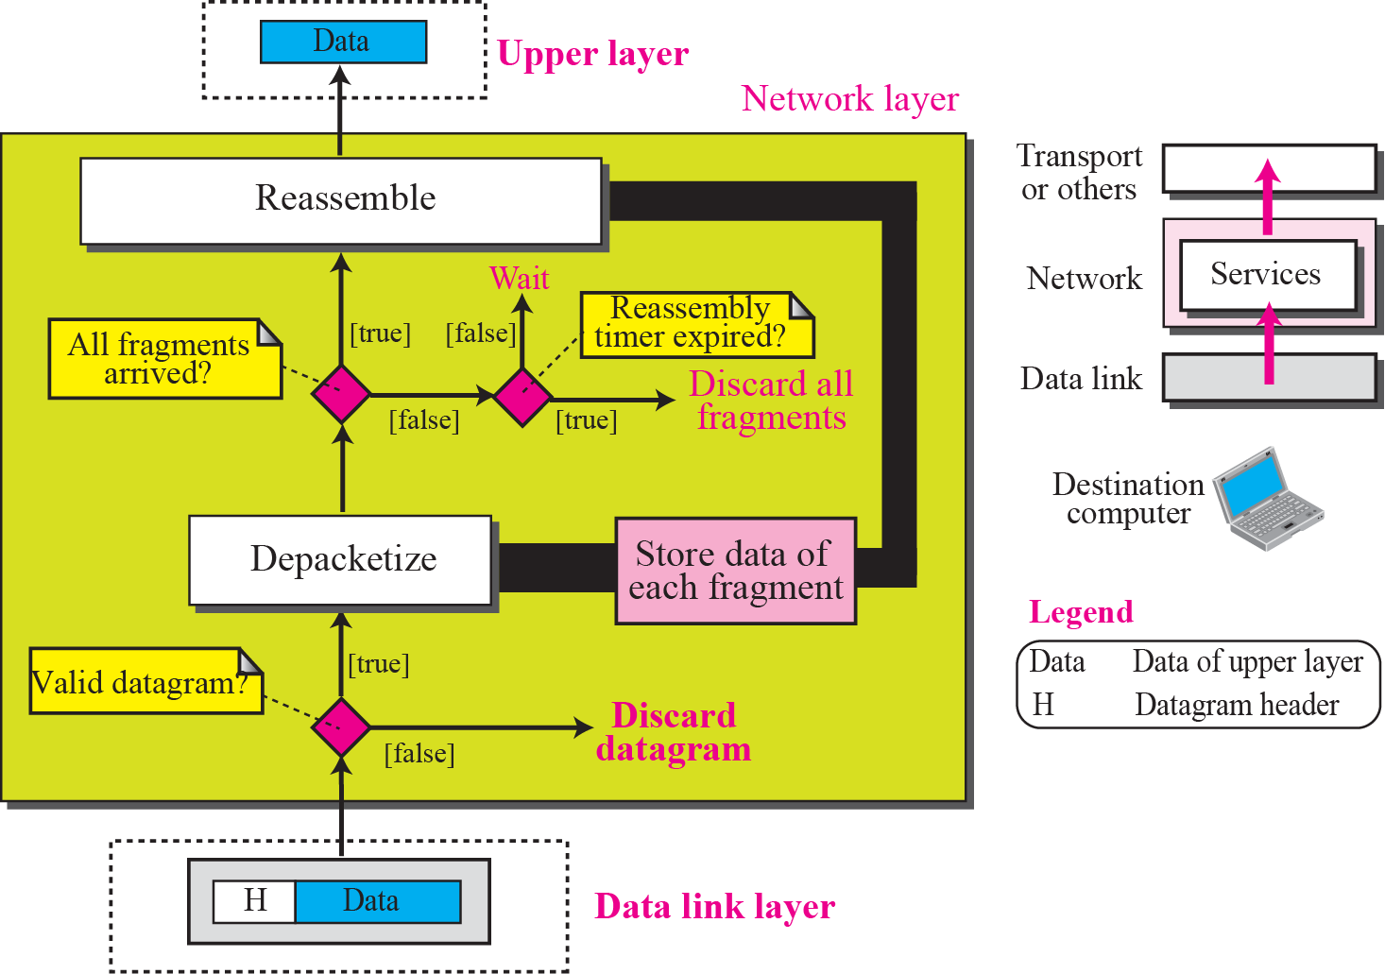
Figure 4.15 Processing at the destination computer

Slide 39
END

